Slide 1
blinkit Grocery Analysis
Developed By
Adarsh Kumar Anil

Slide 2
About blinkit
Blinkit is an Indian instant delivery service that provides groceries, household essentials, and other daily needs within minutes. Formerly known as Grofers, it was rebranded in 2021 to focus on quick commerce, leveraging a network of dark stores for rapid fulfillment.

Slide 3
Problem Statement
In a competitive market where quick service delivery or one stop delivery businesses are growing very fastly. So, it is very important for stakeholders to understand the factors that influencing business and also the factors which can attract more customers towards particular brand or company.
Utilizing blinkit grocery dataset, this project aims to investigate
Relationship between user engagements or choices (Item Type, Outlet Type, Outlet Location) and business success metrices (Total Sales, Avg Rating, No of Items, Items Visibility)

Slide 4
Objectives
Analyze the impact of fat content on total sales.
Identify the performance of different item types in terms of total sales.
Does Outlets segmented by fat content affect total sales?
Evaluate how type of outlet establishment influences total sales.
Analyze the correlation between Outlet Size and Total Sales.
Assess the distribution of sales across different Types of Stores.

Slide 5
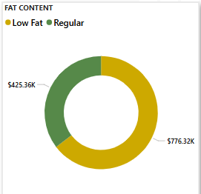
Impact of Fat Content On Sales
More than 64% sales are of Low-Fat grocery products, which is around $776K.
Out of 9K, almost 6K items of Low-Fat groceries are preferred by customers.
However, the average rating is 4⭐ as compared to overall rating of 3.9⭐.

Slide 6
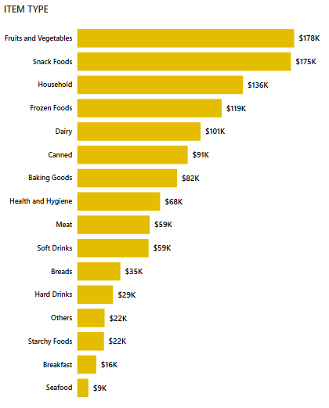
Performance of different item types as total sales
“Fruit and Vegetables” with $178K of total sales is most ordered grocery, followed by “Snack Foods” with $175k and “Household” with $136K sales.
“Starchy Foods” ($22k), “Breakfast” ($16K) and “Seafood” ($9K) is less preferred groceries.
However, each item got 4⭐ Average Rating.

Slide 7
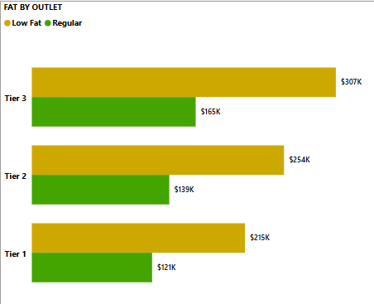
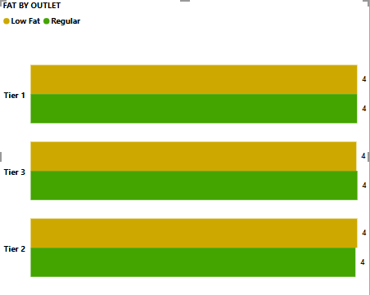
Does Outlets Segmented by Fat Content Affect Total Sales?
Minor difference of $30000 - $40000 have been found in both Low Fat and Regular Fat items total sales.
Even the Average Rating (4⭐) and Average Sales ($141-$143) are identical.

Slide 8
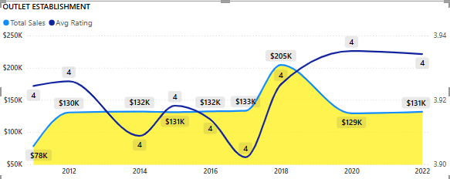
How Outlets Establishment affects Performance of Sales
Year 2017 – 2019 outlets have given the peak performance of $205K.
Rest of outlets have seen saturation of $130K - $133K in their performance.
However, Average Rating experienced a decline, ranging from (3.9⭐ - 4.0⭐) specifically in year (2014 – 2017).
Average Rating not crossed over 4⭐ even once in a decade.

Slide 9
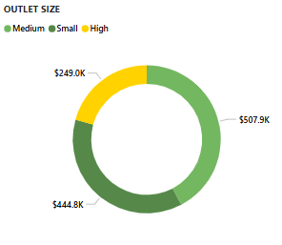
Outlet Size & Total Sales
Medium Size outlets with $507.9K is most preferred by users, followed by Small Size outlet with $444.79K.
With $248K of total sales, Big Outlets doesn’t promise more.

Slide 10
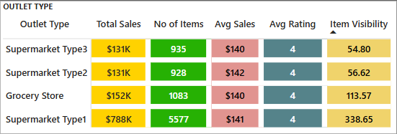
Distribution of Sales Across Different Stores
With $778K of Total Sales, Supermarket Type1 has performed the best in comparison to others.
However, interesting fact is that Higher Visibility directly proportional to Higher Sales.
So, with some advertisement of other Supermarkets (2 & 3) they can perform as well as Supermarket Type1.

Slide 11
Conclusion
Low-Fat products dominate sales (64%) but have a similar rating to Regular Fat items.
Fruits & Vegetables lead total sales, followed by Snack Foods.
Outlet establishment year impacts sales—2017-2019 had peak performance.
Medium-sized outlets outperform big outlets, with higher sales and preference.
Supermarket Type1 leads in total sales, but visibility boosts performance, suggesting a need for better marketing for other store types.

